Slide 1
Employee Satisfaction & Engagement Analysis
Key Trends, Statistical Findings, and Recommendations for Improvement

Slide 2
Data Overview
This analysis is based on survey data collected from employees across various departments within the organization. It measures employee satisfaction, work-life balance, and engagement, along with other important metrics.
Survey includes employees from various age groups (18-24, 25-34, 35-44, 45-54), genders, and ethnic backgrounds (e.g., Asian, Indian, Middle Eastern)
Departments: Data covers multiple departments such as Sales, Product Development, HR, Consulting, and more.
Also measures management support, team collaboration, career development opportunities, and workload fairness.

Slide 3
Employee Experience:
Key Satisfaction Insights
Summary of Employee Engagement, Satisfaction Levels, and
Key Trends

Slide 4
Overall Engagement and Job Satisfaction
We analyzed Overall Engagement and Job Satisfaction among employees using basic descriptive statistics to gain insights into how employees feel about their work and workplace environment.
Both Overall Engagement and Job Satisfaction have relatively low averages, with wide variations in responses, meaning that while some employees are highly engaged and satisfied, a significant portion may feel disengaged or unsatisfied.

Slide 5
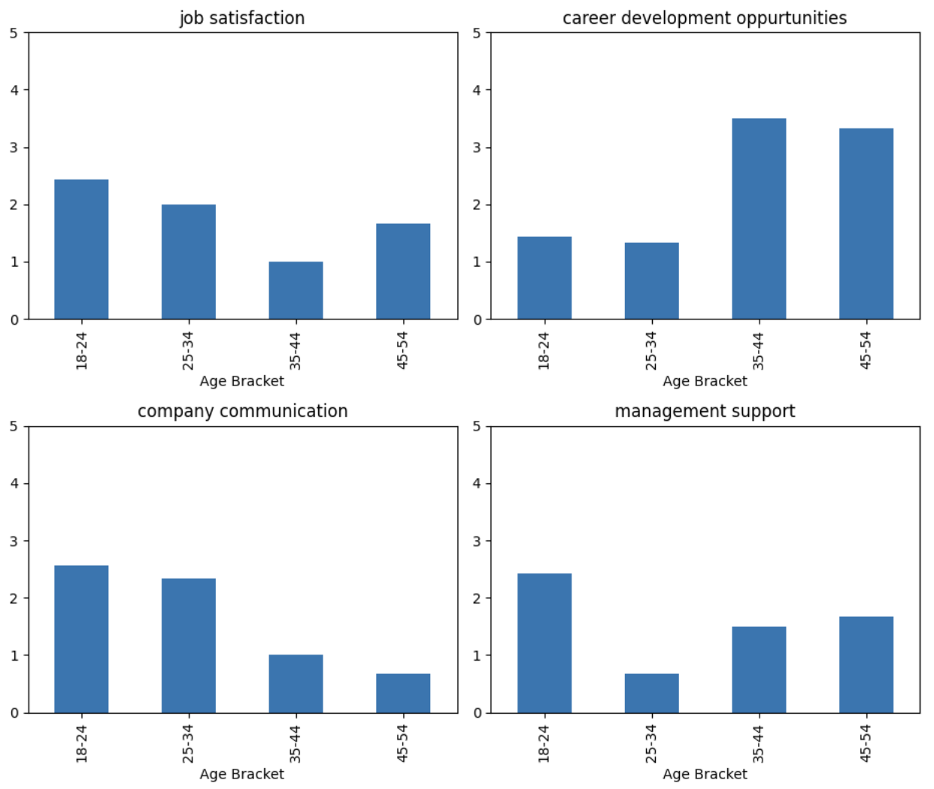
Key Trends
.
Age Group :
18-24: High Job satisfaction, but low Career development opportunities and workplace inclusivity.
25-34: Low management support, especially in Finance and IT.
45-54: High workload fairness.

Slide 6
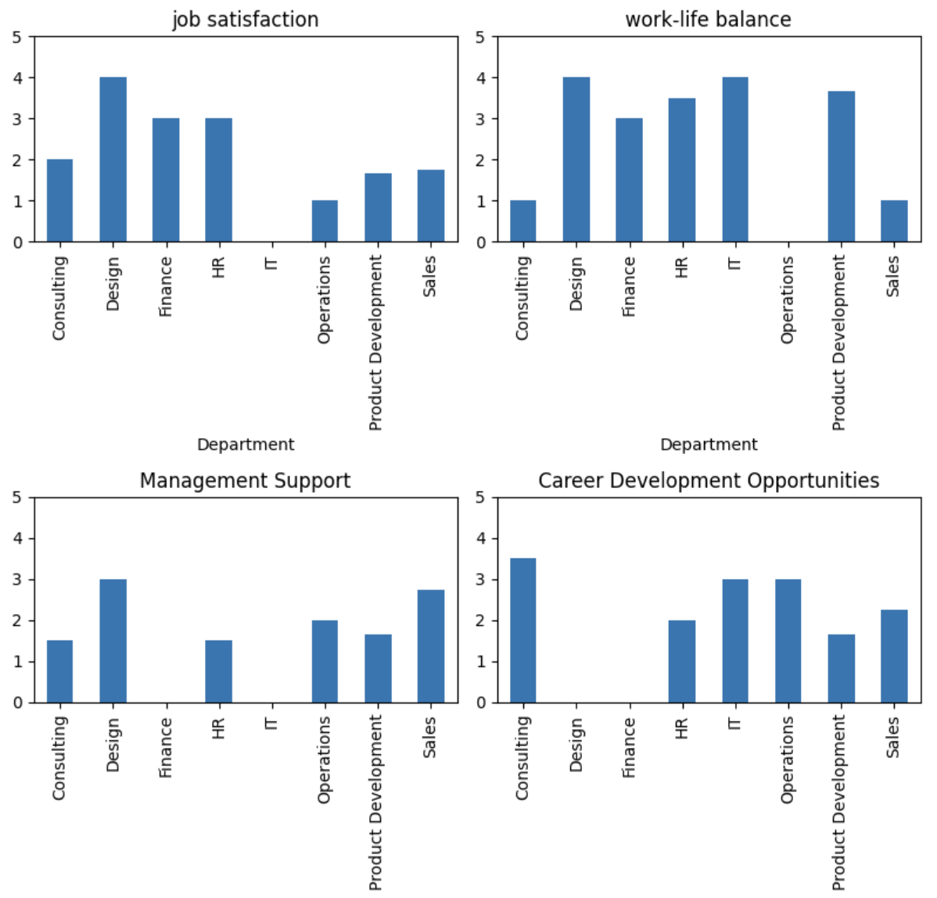
Key Trends
Department :
Sales Department: Low work-life balance, but high job security and management support. Sales executives report the lowest job satisfaction.
Product Development: Low workload fairness
Customer Support & Finance: Low team collaboration, and Finance reports low career development opportunities.
IT & Design: Low engagement and job satisfaction in IT, and low career development in Design.

Slide 7
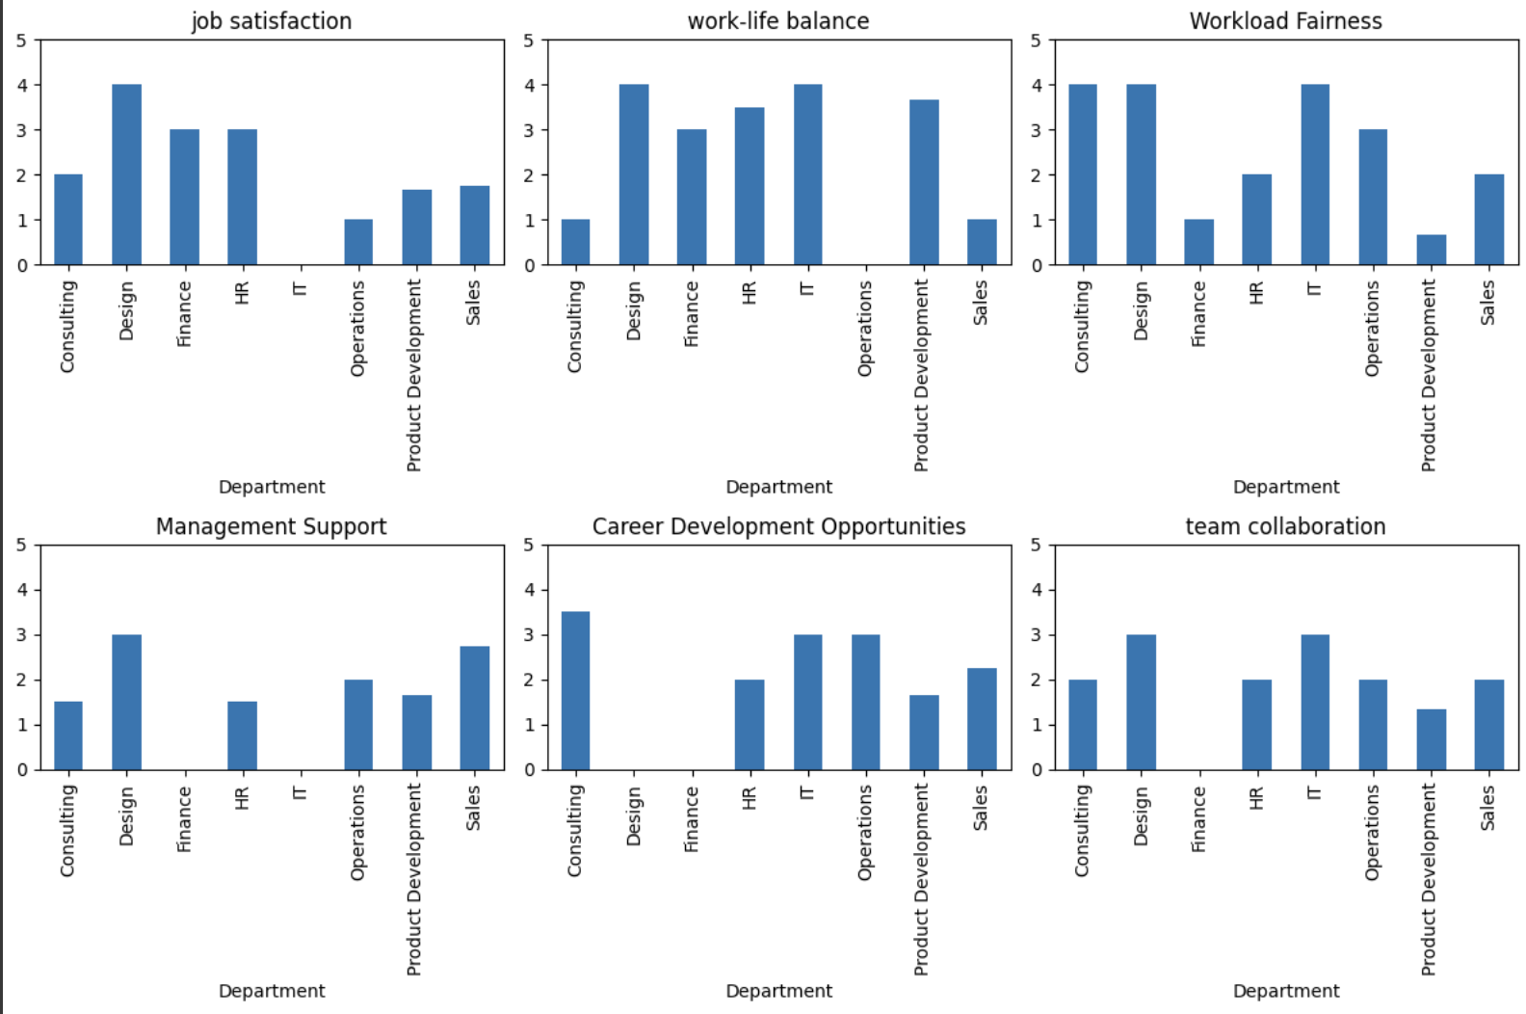
Key Trends
Job Title :
Product Managers & UX Designers: High work-life balance, but UX Designers report very low company communication.
Sales Executives: Lowest job satisfaction across all roles.
Customer Support: Low workload fairness.

Slide 8
Hypothesis Testing
and
Correlation Analysis
Exploring Departmental Job Satisfaction and Correlation analysis between Work-Life balance and Overall-Engagement

Slide 9
Hypothesis Test: Comparing Job Satisfaction in Sales and Product Management
Null Hypothesis
Alternative Hypothesis
Test Method
H₀: There is no significant difference in Job Satisfaction between employees in the Sales and Product Development departments.
This means we assume both departments have similar job satisfaction levels unless the data provides strong evidence to reject it.
H₁: There is a significant difference in Job Satisfaction between employees in the Sales and Product Development departments.
We used the Mann-Whitney U test, which is a non-parametric test, ideal for small sample sizes and when the data does not follow a normal distribution. The test compares the distribution of job satisfaction scores between the two departments.

Slide 10
RESULT
CONCLUSION
The p-value of 1.0 indicates that there is no statistically significant difference in Job Satisfaction between the Sales and Product Management departments. Since the p-value is well above the common significance threshold of 0.05, we fail to reject the null hypothesis, meaning the data does not provide enough evidence to suggest a meaningful difference in satisfaction levels between these two departments.
U statistic - 6.0
P- Value - 1.0
Based on the Mann-Whitney U test, we conclude that job satisfaction levels are similar between employees in the Sales and Product Development departments. This suggests that, despite possible differences in roles or departmental responsibilities, both groups of employees perceive their job satisfaction in a similar way.

Slide 11
Pearson Correlation analysis between Work-Life Balance and Overall Engagement
In our analysis, we examined the relationship between Work-Life Balance and Overall Engagement using correlation analysis. The resulting Pearson correlation coefficient is -0.361, which offers several insights:
A correlation of -0.361 indicates a moderate negative relationship, meaning as Work-Life Balance decreases, Overall Engagement tends to increase, though the relationship is not strong.
This may suggest that highly engaged employees are more willing to sacrifice work-life balance, or that some employees feel more engaged when they spend more time on work.
Further investigation is needed to determine if this trend is consistent across different departments or demographics, as correlation coefficient is really Small.
Work-Life Balance = Overall-Engagement
And vice-versa

Slide 12
Supplementary Insights

Slide 13
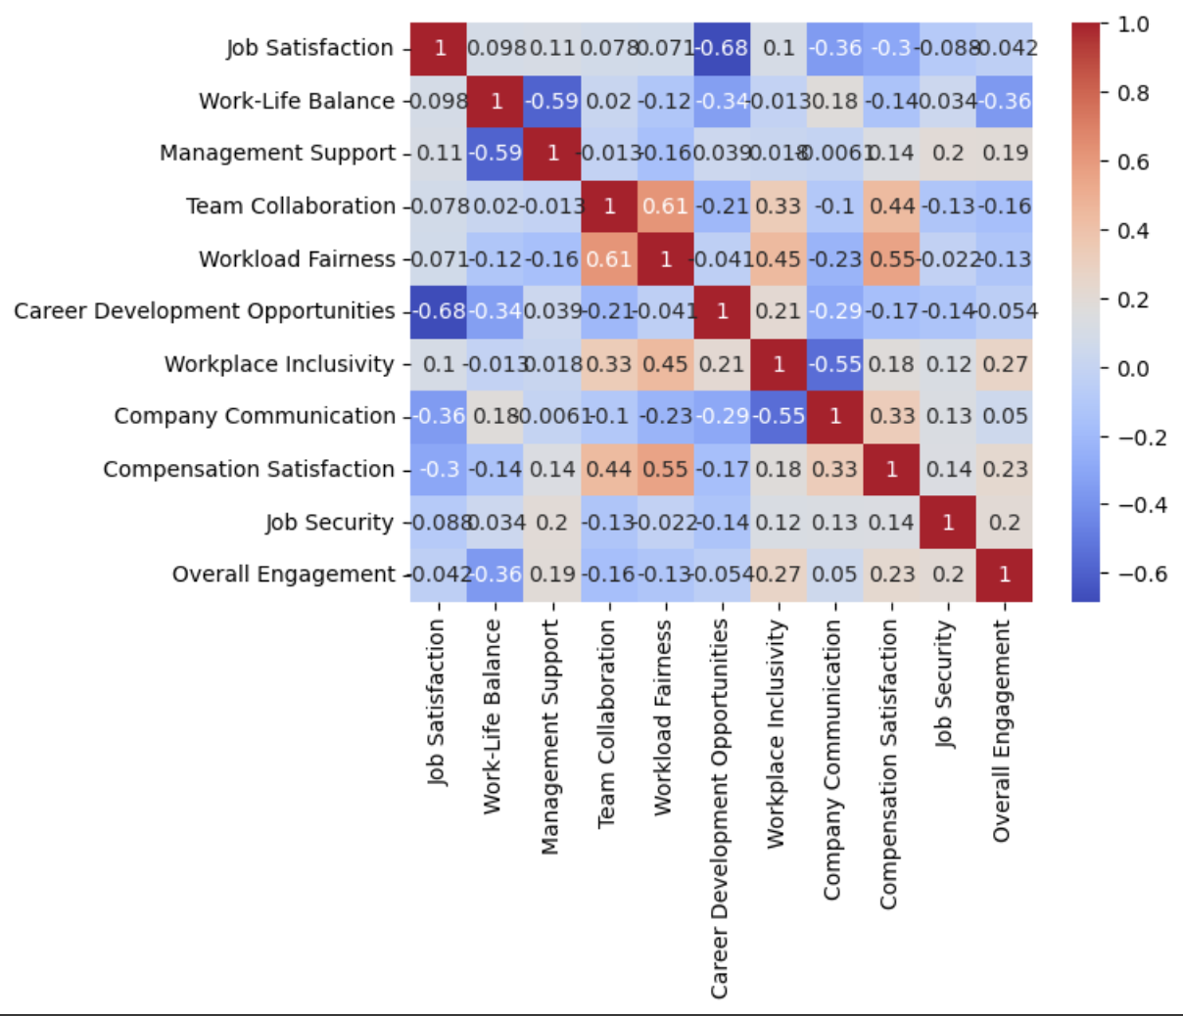
Lack of career growth opportunities strongly correlates with lower job satisfaction and poor company communication.
Low management support is linked to poor work-life balance, affecting employee well-being.
Higher engagement is associated with a slight decrease in work-life balance.
Better team collaboration is positively linked to fairer workload distribution.
Lower compensation satisfaction leads to lower overall job satisfaction.

Slide 14
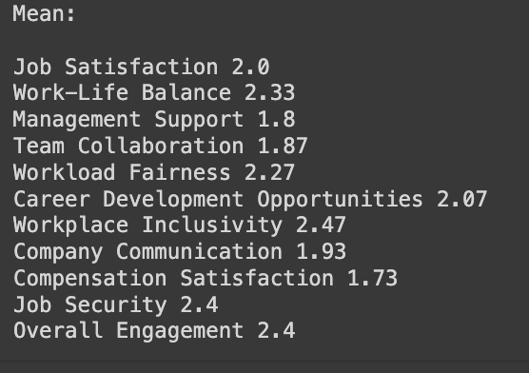
Low Job Satisfaction (2.0) and Management Support (1.8) suggest dissatisfaction and poor leadership, impacting employee morale.
Team Collaboration (1.87) and Workload Fairness (2.27) are perceived as below satisfactory, indicating potential issues with teamwork and equitable workload distribution.
Career Development Opportunities (2.07) are limited, which could hinder employee growth and retention.
Company Communication (1.93) is weak, implying a need for better transparency and information flow within the organization.

Slide 15
Recommendations for Improving Employee Satisfaction and Engagement

Slide 16
Recommendations
Invest in Career Development Programs: Implement mentorship, training, and clear advancement paths to improve career growth opportunities and increase job satisfaction.
Enhance Management Support and Communication: Provide leadership training and create regular communication channels to ensure employees feel connected and supported by management.
Improve Work-Life Balance: Introduce flexible work arrangements, such as remote working and flexible hours, to reduce employee burnout and improve overall well-being.
Foster Team Collaboration and Fair Workload Distribution: Promote cross-departmental collaboration and conduct regular workload assessments to ensure tasks are distributed fairly and teamwork is improved.

Slide 17
THANK YOU
Check out tableau-workbook and Spreadsheet where I found multicollinearity between features to eliminate bias.
G-drive Link - https://drive.google.com/drive/folders/1-v9HBkLlBuf1fYvtlB2g1AKmvp90zqDc?usp=drive_link
Tableau link - https://public.tableau.com/app/profile/dhruv.parikh7989/viz/Makerble/Dashboard2
Git-Hub link - https://github.com/KaiHaVertzz29/Makerable

